Slide 1

CYBER BULLYING
BT5153 Group 5
Mukeshwaran Baskaran (A0165086Y)
Nanhai Zhong (A0231953E)
Ng Boon Khai (A0231863E)
Kuan Ju Lin (A0231904M)
Chen Hong (A0231993X)
Notes:
Good Evening everyone. My name is Mukesh and I am from Group 5. My group consists of myself, vanessa zhong, boon khai, kuan ju lin and chen hong. We will be covering the topic of cyber bullying classification for our project.

Slide 2
TABLE OF CONTENTS
1
2
3
4
5
6
Introduction
Objective & Application
Datasets & EDA
Cyberbullying Text Detection
Conclusion & Future Works
Cyberbullying Image Detection
Notes:
This presentation will have an introduction, followed by objectives, application, our datasets and the relevant data processing and modelling and finally a conclusion and our ideas for future work.

Slide 3
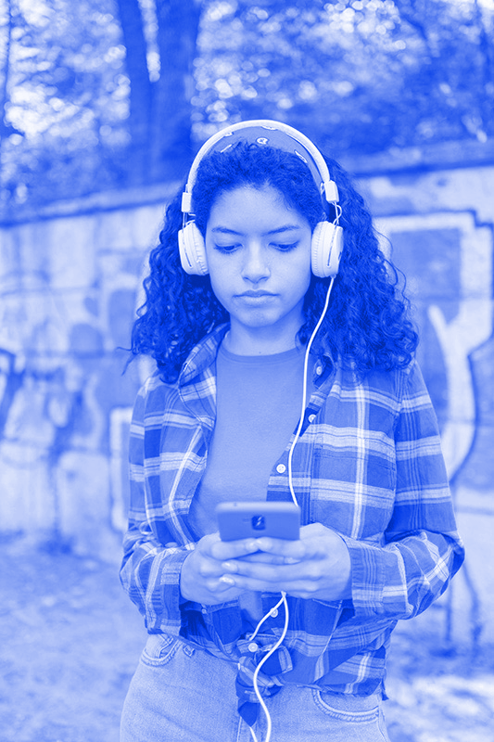
INTRODUCTION
36.5% of school going children have been cyberbullied.
Notes:
36.5 percent of school-aged children have been cyberbullied in the past, which has resulted in negative consequences such as poor academic performance, depression, and even suicidal ideation. Furthermore, aggressors are frequently anonymous, making it impossible for authorities to intervene. Reducing cyberbullying would vastly improve the mental health of children.

Slide 4
OBJECTIVE
Identify instances of cyberbullying.
Notes:
Correctly identifying cyberbullying on the internet, is critical when implementing effective intervention techniques to stop the spread of cyberbullying. Machine learning methods, like Natural language processing and computer vision, are well suited for this classification task.

Slide 5
APPLICATION
Censor instances of cyberbullying with our models.
Notes:
Modern youth tend to spend a lot of their free time on social media platforms where they can be easily exposed to harmful content and cyberbullying. Social media platforms, like Twitter, Facebook and TikTOk, have faced a lot of difficulty in moderating their content. Our NLP and CV models can be deployed on these platforms to reduce the exposure of cyberbullying to youth.

Slide 6
DATASET 1
Textual dataset of tweets from Kaggle.
Notes:
We have used two datasets in this project, a textual dataset where we ran NLP models and an image dataset where we ran computer vision models. The first textual dataset was obtained from Kaggle,.
Was (which was also utilized in Ref (Wang et al., 2020).)

Slide 7
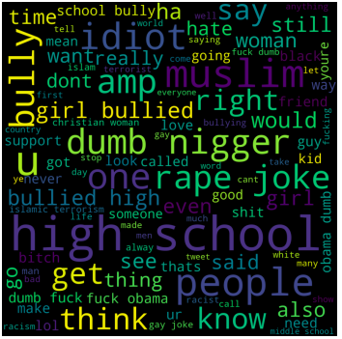
Overview
47692 rows and 2 columns
(tweet text & cyberbullying type)
no missing values
relatively balanced classes
Common words
"bullying" → not-cyberbullying
"rape", "gay", "funny" → gender
"muslim" → region
N-word → ethnicity
Notes:
The dataset has 47692 rows and 2 columns in it.
Tweet text and cyberbullying type are the columns. Both columns are of the datatype "object" and are strings. The dataset has no missing values and relatively balanced classes. Our wordcloud shows that minorities like homosexuals and muslims are more prone to be bullied online.

Slide 8

DATASET 2
Cyberbullying image dataset
source:
Notes:
For the image cyberbullying dataset, the classes of dataset are imbalanced but acceptable, with 14,650 images belonging to the non-cyberbullying class, and 5,201 belonging to the cyberbullying class. The dataset was obtained directly from the authors of the research paper as shown in the slide, Vishwamitra et al.

Slide 9
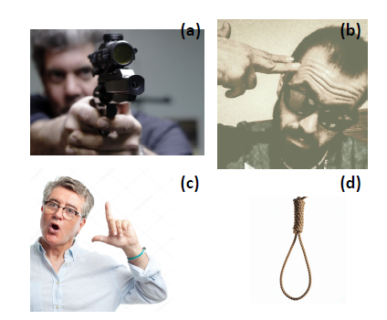
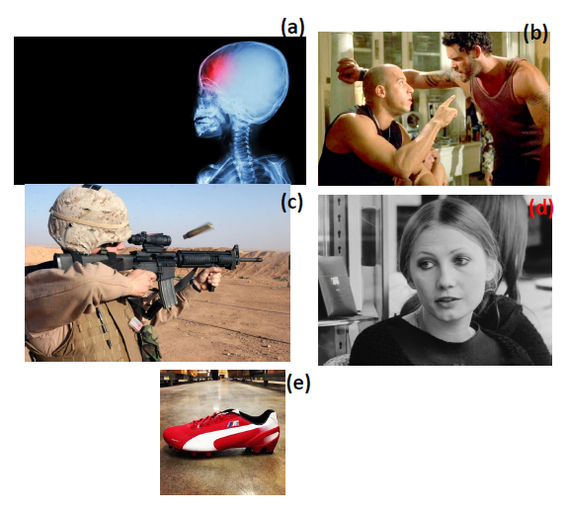
(Non) cyberbullying images examples
cyberbullying
non-cyberbullying
source:
Notes:
Here are some examples of the cyberbullying image dataset. The figure on the left corresponds to cyberbullying images, while the figure on the right corresponds to non-cyberbullying. According to Vishwamitra et al, the difficulty of classifying image cyberbullying is that it is contextual. For example in the left figure, objects such as guns, or hanging rope are associated with cyberbullying as they suggest physical harm of some sort. On the other hand, on the right side figure, we see in panel ( c), a soldier firing a gun, but this image should not be a cyberbullying image as the soldier is just doing his job. Other types of objects such as a football shoe as shown in panel (e ) of right figure should also not be associated with cyberbullying. Likewise, for the skull image in panel (a) of right figure, it should not be a cyberbullying image as there is no contextual information suggesting harm to the victims.
Furthermore, the facial expression of a person are also important contextual cues in cyberbullying, as shown in the left figure panels (b) and (c ). Aggressive facial expressions are associated with cyberbullying. On the other hand, in right figure panel (b), although the facial expression of the two persons are quite intense, they are not associated with cyberbullying. This is likely due to the fact that their body posture are not faced towards the front. All of the image cyberbullying classification are contextual. For example, in the right side figure panel (d), although the woman’s body posture is facing to the front, her expression is calm, so it is also not a cyberbullying image.
We will discuss more on how to extract the contextual factors in later section.

Slide 10
Cyberbullying
Text Detection
Data-Preprocessing
Statistical Language Models
Neural Language Models
Notes:
First, we remove the hashtag, mention mark and URLs. Then, turn all text into lowercase and lemmatize the words with WordNetLemmatizer to transform them into dictionary form. Next, remove punctuation and stopwords. Last but not least, convert emoji into words with python package demoji.

Slide 11
Statistical Language Models
Word-Level Encoding
Probabilistic Models
Bag-of-Words
Term Frequency-Inverse Document Frequency
Naïve Bayes
Logistic Regression
Support Vector Machine Decision Tree
Notes:
BoW is a count of word occurrences, whereas TF-IDF encoding reflects the relevance of the term to the document in a collection of documents or corpus.

Slide 12
Performance Comparison for Statistical Language Models
Out-of- Sample Accuracy
Encoding Methods
Similar accuracy among different encoding methods.
 | NB | LR | SVM | DT
BoW | 74% | 81% | 81% | 78%
TF-IDF | 73% | 81% | 81% | 78%
Probabilistic Models
LR & SVM outperform the others.
SVM is very time consuming.
Notes:
Table shows that there is no big difference of accuracy between different encoding methods. Among different basic classification models the Logistic Regression and SVM outperform the Naïve Bayes and Decision Tree. However, the training process of SVM model is very time consuming compared with Logistic Regression model.

Slide 13
Performance Comparison - Recall
Class | NB BoW | NB TFIDF | Diff | LR BoW | LR TFIDF | Diff | SVM BoW | SVM TFIDF | Diff | DT BoW | DT TFIDF | Diff
not_cyberbullying | 30% | 30% | 0% | 52% | 55% | 3% | 46% | 52% | 6% | 48% | 46% | -2%
gender | 80% | 80% | 0% | 82% | 80% | -2% | 80% | 79% | -1% | 81% | 82% | 1%
religion | 98% | 97% | -1% | 93% | 95% | 2% | 93% | 93% | 0% | 91% | 92% | 1%
other_cyberbullying | 42% | 37% | -5% | 64% | 60% | -4% | 75% | 64% | -11% | 52% | 56% | 4%
age | 99% | 98% | -1% | 97% | 97% | 0% | 96% | 97% | 1% | 96% | 96% | 0%
ethnicity | 96% | 93% | -3% | 98% | 98% | 0% | 98% | 98% | 0% | 97% | 97% | 0%
The classes with clear themes are easier to be detected.
Among classes with clear themes , gender has lower recall.
NB with BoW performs better than NB with TF-IDF
DT with TF-IDF performs better than DT with BoW.
Notes:
Table 4.2.1-2 shows that the classes with clear themes are easier to be detected by those models compared with not_cyberbullying and other_cyberbullying. Among those classes with a clear theme, the recall of gender is only around 80% while recalls of other classes are higher than 90%. In addition, although accuracy of different encoding methods is similar, the recalls with different encoding methods are different. When it comes to recall, the Naïve Bayes model with BoW has better performance than the Naïve Bayes model with TF-IDF, while the Decision Tree model with TF-IDF performs better than the Decision Tree model with BoW.

Slide 14

Neural Language Models
LSTM + W2V
Long Short-Term Memory
Word2Vector
Basic BERT
Bi-directional Encoder Representations from Transformers
RoBERTa
A robustly optimized method that improves on BERT
Notes:
Apart from the statistical model, we also explored three neural language models.
LSTM with Word2Vec embedding
Basic BERT and
RoBERTa
For the subsequent slides, I will briefly introduce the model and compare the out-of-sample performance

Slide 15
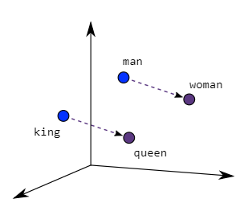
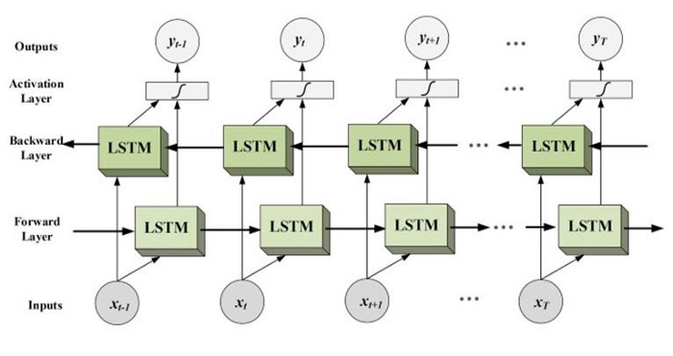
LSTM + Word2vec
How it works
Word2Vec creates context-free vectors of the words
Bi-LSTM makes use of information in both directions forward(past to future) or backward (future to past)
Word2vec
LSTM
Notes:
Word2Vec is an embeddings created from context-free vectors of the words that represent the context of the individual words
The LSTM variant used to classify the embeddings is Bidirectional LSTM is a Neural Network architecture that makes use of information in both directions forward or backward.

Slide 16
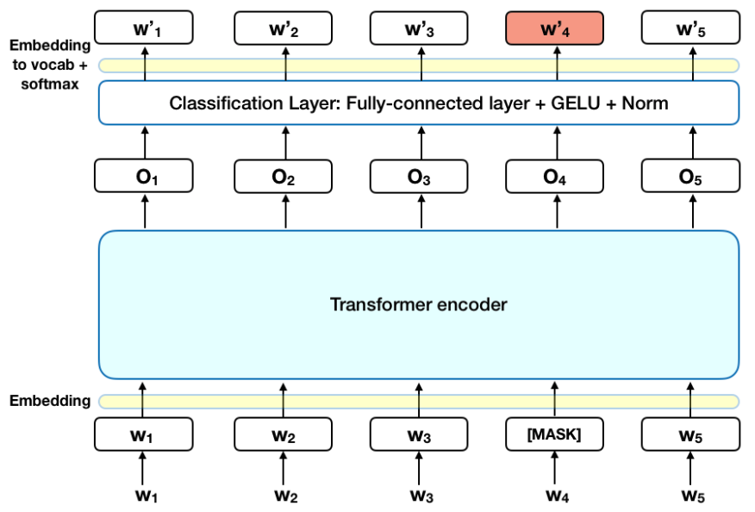
Basic BERT
How it works
Context-based language model
Trained on transformer architecture
Can be fine-tuned with just one additional output layer
Notes:
BERT is a context-based language model which is designed to be bidirectionally trained on transformer architecture
Subsequently, the pre-trained BERT model can be fine-tuned with just one additional output layer.

Slide 17
RoBERTa
Optimize upon basic BERT
training the model longer, with bigger batches, over more data
removing the next sentence prediction objective
training on longer sequences
dynamically changing the masking pattern applied to the training data
How it works
Basic BERT which is significantly undertrained.
The central idea was to train the same BERT model for longer (more epochs) and on more data.
Notes:
We further explored a variant of BERT called Roberta. The motivation of this variant is to improve upon basic BERT which is significantly undertrained.
The central idea with this variant was to train the same BERT model for more epochs and on more data, with the aim to enhance the model capability to capture contextual meanings of words.

Slide 18
Performance Comparison for Neural Language Models
Neural Language Models
Out-of- Sample Accuracy
BERT models performs better than Word2Vec due to its contextual embeddings.
RoBERTa as a more optimized variant of basic Bert performs the best.
Model | Accuracy
LSTM with Word2Vec | 80%
Basic BERT | 84%
RoBERTa | 87%
Notes:
Here is the out-of-sample accuracy of the neural language models. To simplify the comparison, we only look at the accuracy score since the class labels are rather balanced.
BERT models performs significantly better than LSTM with Word2Vec, due to the context-based embeddings of BERT which can better capture expressions and sentiments.
Out of the two BERT models, RoBERta surpasses basic BERT by having 87% accuracy, which is the best performance we had achieved in this classification task

Slide 19
Text Augmentation
Synonym replacement
Back translation
New sentences generated by replacing words in the original sentence with synonyms
New sentences generated by translating the original sentence to another language, and translating it back to the original language.
Notes:
We also explored text augmentation techniques to see if enrichment of data samples could result in an increase in performance.
We used synonym replacement, which generates new sentences by replacing words in the original sentence with synonyms,
As well as back translation, which generate new sentences by translating the original sentence to another language and translating it back to the original language.

Slide 20
Performance Comparison Wrap-up
Type | Model | Accuracy
Statistical | NB (BoW) | 74%
 | NB (TF-IDF) | 73%
 | DT | 78%
 | LR | 81%
 | SVM | 81%
Natural language | LSTM with Word2Vec | 80%
 | Basic BERT | 84%
 | RoBERTa | 87%
 | RoBERTa + Text augmentation | 87%
Observations
Text augmentation has little to no effect on the performance in this application
In conclusion, neural language models without text augmentation, perform better than statistical models, notably RoBERTa which performs exceptionally better than the others
Notes:
This slides summarizes all the models and techniques we have explored
Looking at the last two rows, text augmentation shows little to no effect on the performance in this application. Even with text augmentation, RoBerta still achieved similar performance at 87% accuracy .
We believe that it is due to loss in information that captures cyberbullying content during word replacement and translation
In conclusion, neural language models without text augmentation, perform better than statistical models, notably RoBERTa which performs exceptionally better than the others

Slide 21
Cyberbullying
Image Detection
Notes:
Now, here comes to our next topic.We will discuss cyberbullying image classification. For this task, we built a Convolutional Neural Network to perform this task.

Slide 22
Data Pre-Processing & EDA
The classes of dataset are imbalanced but acceptable, with 14,650 images belonging to the non-cyberbullying class, and 5,201 belonging to the cyberbullying class.
All images were resized to 100 × 100 pixels, and scaled by dividing by 255.
Randomly select 80 percent of our dataset for training and 20 percent of the dataset for testing.
Notes:
As mentioned before, the classes of dataset are imbalanced but acceptable for the image cyberbullying dataset. Before building our model, some preprocessing should be done. All image data were resized to 100 × 100 pixels, and scaled afterward.
We then split the data into training and testing parts.

Slide 23
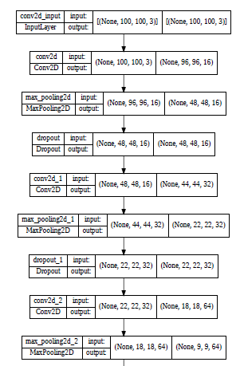
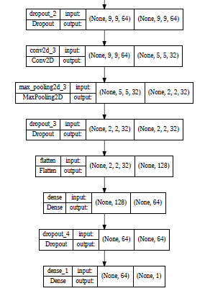
Convolutional Neural Network
Notes:
CNN model was applied in our case. It is a type of neural network model which is well known for working with the images and videos.
A series of convolution layer, followed by Max pooling and a Dropout layer were built in the first part of deep learning model, so as to to reduce the dimensionality, removes noise from input data and retains only the significant values. Therefore, model can better capture the overall pattern.
After the first series of layers, a flatten layer was connected between the following Dense layer and the previous ones to flattens the multi-dimensional input tensors into a single dimension. Several Dense and Dropout layers were constructed afterwards.

Slide 24
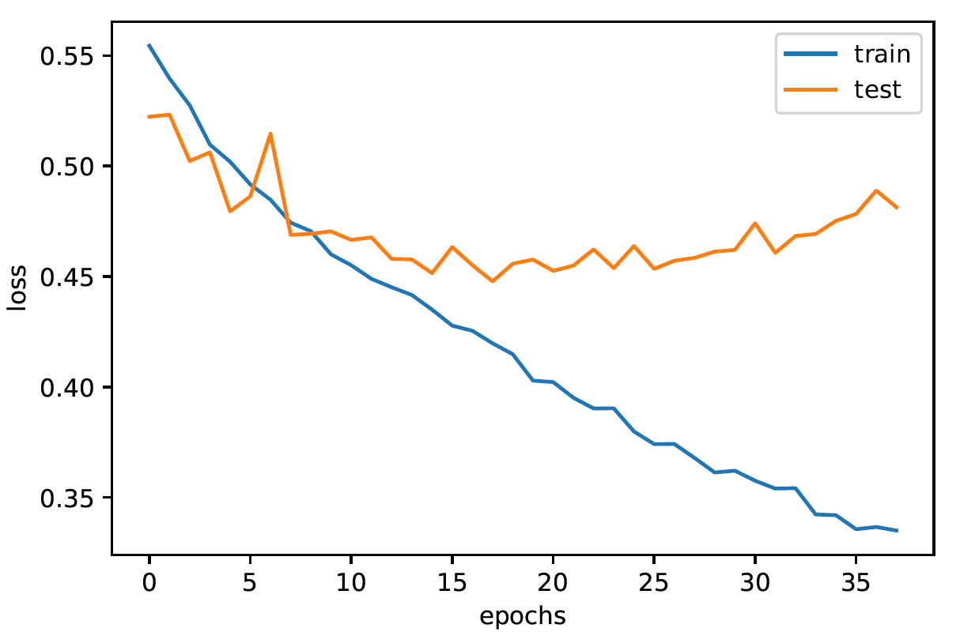
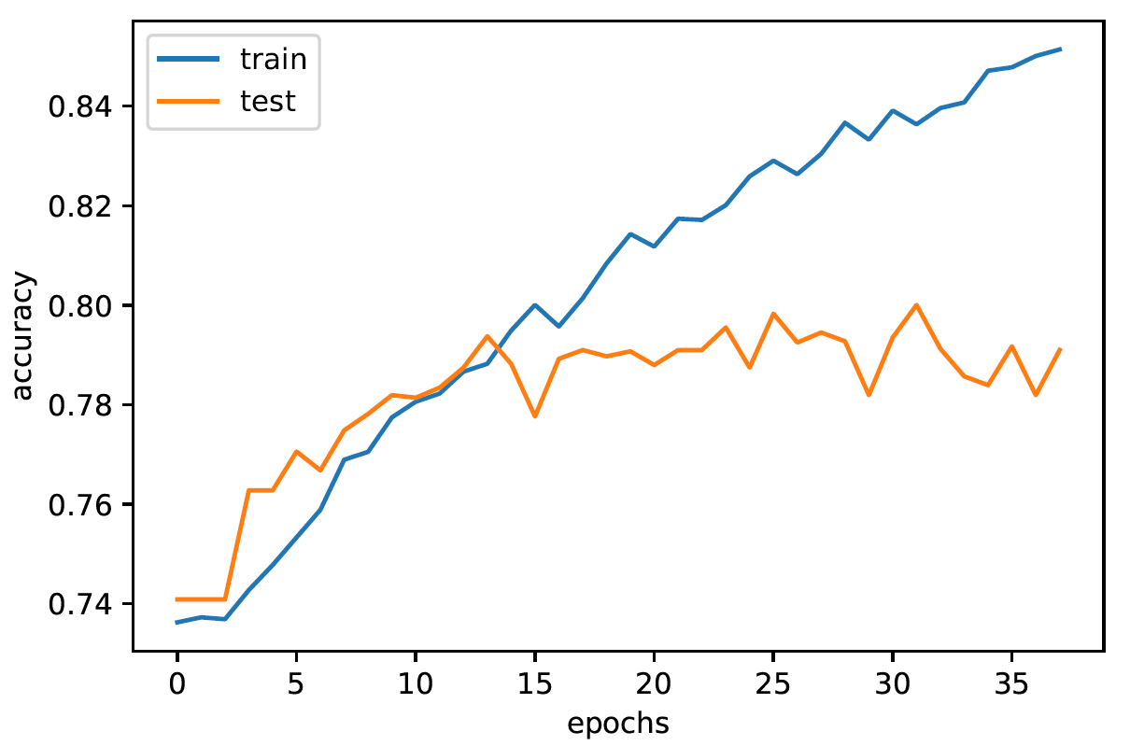
CNN train/test loss/accuracy
Epochs set to be 50, with early stopping & callback
When epochs = 15, model starts overfitting
Best validation accuracy of 0.79 (assuming threshold Z=0.5)
Notes:
During the training, we set the Epochs to be 50, with callback monitoring the validation loss for early stopping and storing the best parameters.
The training loss decreases as the epochs increases, when it comes to epoch equals around 15, it seems like start to overfit the data, since testing loss start to increase at this moment. On the right hand side is the accuracy performance. Our model can reach 79% accuracy on the testing data, which outperforms the baseline model if we assume a model predicts every data points to be non-cyberbullying class.

Slide 25
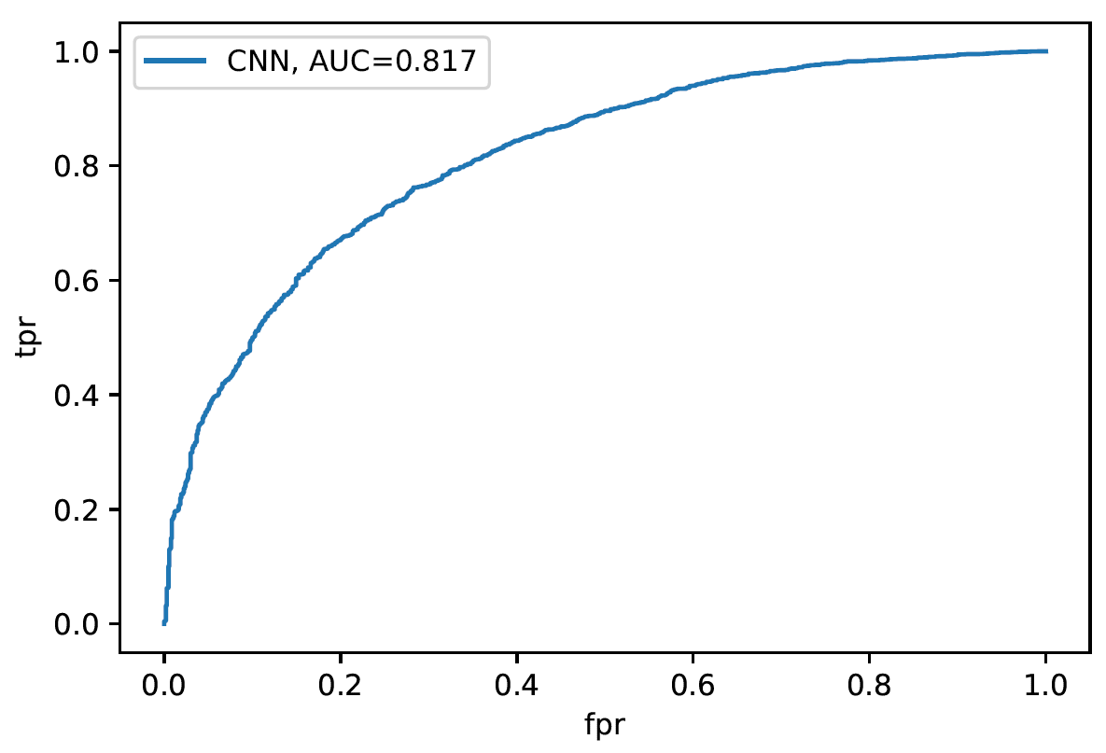
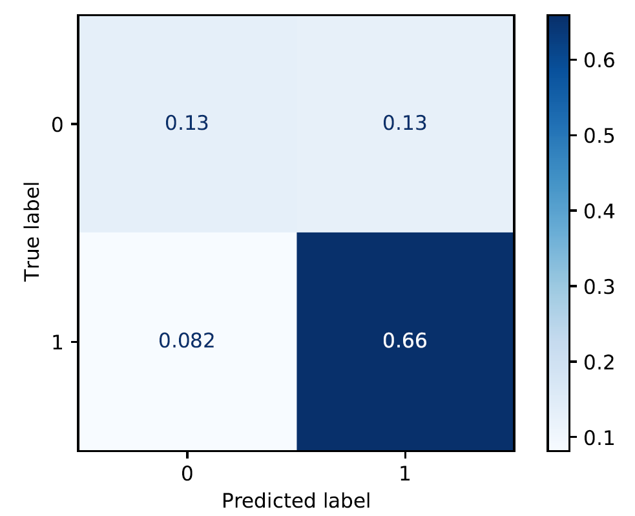
ROC curve and confusion matrix
Class 0: cyberbullying
Class 1: non-cyberbullying
AUC = 0.817
Precision = 0.617
Recall = 0.508
Notes:
We also use ROC-AUC and confusion metrics as one of evaluation methods.
The ROC analysis provides a means of reviewing the performance of a model in terms of the trade-off between False Positive Rate and True Positive Rate.
Our model reach 0.817 in terms of AUC score.
The figure on the right hand side demonstrates the confusion matrix, with precision equals 0.617, and recall equals 0.508.
Next, I will hand over to Chen Hong for further discussion of our image classification model.

Slide 26
Improvement to cyberbullying image classification
Body-pose factor extraction: Use OpenPose
Facial emotion factor extraction: Use OpenFace
Gesture factor extraction: Use Google Cloud Vision API
Object factor extraction: Use YOLO (You Only Look Once object detection algo)
Social factor extraction (anti-LGBT etc): It’s difficult, the authors self-label according to information within the research literature
source:
Notes:
While the basic baseline CNN model performs adequately, achieving validation accuracy of 0.79, and recall of 0.508, there are still room for improvement. Note that for the CNN model, we just feed the training image and class label without doing anything else. In other words, the CNN model may not have adequately learned the contextual information of cyberbullying images.
In the research paper of Vishwamitra et al, the novelty of their contribution lies in being the first of its kind to 1), not only provide a comprehensive cyberbullying image dataset, but 2), to contextualise the factors involved in cyberbullying images. We discuss in this slide the approach taken by them to do image factor extraction to build a multi-modality learning model together with CNN to achieve a high out-of-sample classification accuracy of 93.36%.
Mainly, there are 5 contextual factors to consider: Body-pose, facial emotion, hand gesture, objects, and social factors such as anti–LGBT or hate speech related factors. For body pose, the authors used OpenPose to extract where the persons involved in images are facing. By doing cosine similarity analysis of the body pose occurrences in cyberbullying and non-cyberbullying images, they found that body posture that directly faces the front are more likely to be associated with cyberbullying, while non-front facing postures are more likely be to associated with non-cyberbullying.
In facial emotion factor extraction, the authors used OpenFace to extract the emotions of the persons involved in images. Surprisingly, the cosine similarity analysis revealed that cyberbullying images tend not to show strong emotions. Counter intuitively, cyberbullying images subjects tend to show happy emotions, perhaps as a way to mock the victims.
In hand gesture factor extraction, they used Google Cloud Vision API. Hand gestures such as loser, middle finger, thumbs down, or gun point are associated with cyberbullying images.
For object factor extraction, the authors used YOLO, you only look once object detection algorithm. Although majority of cyberbullying images do not have any objects, some portion of them contain threatening objects such as gun or knife to intimidate victims. The object factor is also an important feature.
Finally, for social factors such as hate speech or anti LGBT factors, for example “black face” or “hanging rope”, it is difficult currently to do factor extraction. For this factor, the authors manually analysed the images and hand label these factors.
Finally, with these factors obtained, the authors built a multi-modality model that combines the images of the image dataset with the features of the extracted feature. With this ML model, they achieved a mean accuracy of 93.36%.

Slide 27
Conclusion
Cyberbullying text classification
Cyberbullying image classification
Notes:
In conclusion, in this project, we tackled the problem of machine learning classification of cyberbullying, both for the text data, and the image data separately. For the text data, we considered traditional approaches such as statistical language models, for example bag of words, tfidf, and used these features to train classifical classifiers such as svm, lr, dt, and naive bayes. These classifiers performed adequately, achieving average accuracy of about 74-81%.
Next, for text data classification, we also considered advanced models such as neural language models. For neural language models, we considered LSTM with word2vec, BERT, and Roberta. As expected, these deep learning models performed better, achieving average accuracy of about 80-87%. Since deep learning models perform best when there is a lot of data, we also experimented text augmentation techniques such as back translation, and synonym replacement. We found that text augmentation, when applied to Roberta, had little to no effect in terms of performance.
The second part of our project involves image cyberbullying classification. For this problem, we contacted the authors of the research paper mentioned earlier to get access to their novel comprehensive labelled dataset. We built a CNN model to perform the classification task and achieved validation accuracy of 0.79, in agreement with the baseline CNN model performance stated in the research paper. Further, we discussed the various contextual factor information such as body-pose, facial expression, hand gesture, objects, and social factors which could be used as features to build an effect multimodality machine learning model. Due to time limitation and technical difficulty of the factor extraction, we were not able to experiment with this model.
To round off the presentation, it has to be said that cyberbullying is an important problem to tackle. Since more people are on social media these days, and victims of cyberbullyings, especially children, are reported to suffer academically, or even struggle with suicidal thoughts, preventing cyberbullying is an important problem to tackle. We hope that our work contributes to solving this problem and bring society one small step closer towards a better world.

